Slide 1
EGNOS: free accuracy for mapping and GIS applications

Slide 2
Table of contents
EGNOS basics: architecture and technical parameters
EGNOS benefits for mapping and GIS
EGNOS-enabled devices
EGNOS applications and success stories
EGNOS user support
Questions and answers

Slide 3
Table of contents
EGNOS basics: architecture and technical parameters
EGNOS benefits for mapping and GIS
EGNOS-enabled devices
EGNOS applications and success stories
EGNOS user support
Questions and answers

Slide 4
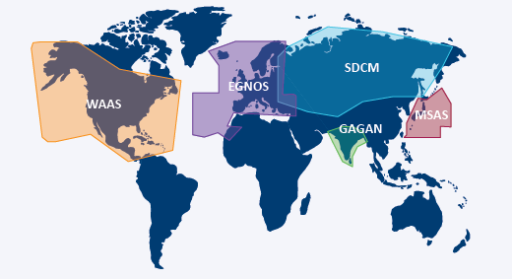
EGNOS background
EGNOS (European Geostationary Navigation Overlay Service) is the free European satellite-based augmentation system (SBAS) over the L1 signal of GPS
EGNOS was designed for aviation purposes, but it is also suitable for usage on a multitude of other ground applications
EGNOS is interoperable with other SBAS systems (map below)
In the future (>2023):
EGNOS will augment also Galileo
EGNOS will broadcast dual-frequency corrections

Slide 5

EGNOS system
2 x MCC
39 x RIMS
Mission
Control
Centres
Ranging
& Integrity
Monitoring
Stations
GPS signals
EGNOS application area
4 x NLES
2 Geostationary Satellites
Navigation
Land Earth
Stations
EGNOS signal in space (SiS) coverage footprint
ESSP premises
5

Slide 6



EGNOS organization
programme exploitation manager
users
design agent
industry
service provider
safety authority

Slide 7
EGNOS services
OS service release: 1 October 2009
EGNOS OS Service Definition Document (SDD)
Agriculture, maritime, road, rail, mapping and GIS …
No regulatory framework
SoL service release: 2 March 2011
EGNOS SoL Service Definition Document (SDD)
Regulatory framework that obliges to use certified EGNOS equipment
Aviation: LPV landing approaches without depending on ground infrastructure
EDAS service release: 26 July 2012
EDAS Service Definition Document (SDD)
User registration is required
Provision of EGNOS/GPS/GLONASS data through the Internet
DGNSS and RTK corrections in the surroundings of the RIMS

Slide 8
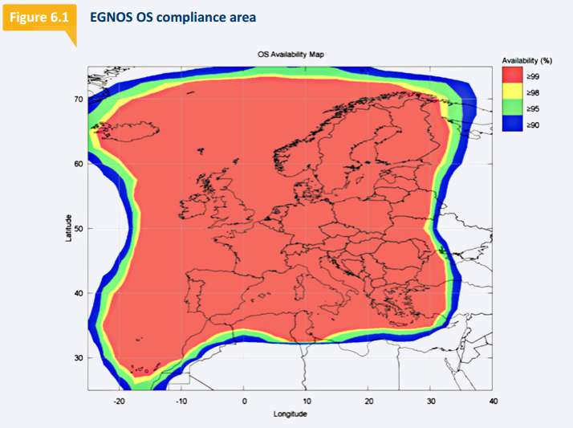
EGNOS Open Service
EGNOS Open Service application area
Measured accuracy
RIMS | Horizontal (95%) | Vertical (95%)
Aalborg | 0.6 m | 1.6 m
Berlin | 0.7 m | 1.3 m
Málaga | 0.8 m | 1.1 m
... | ... | ...
May 2018 (monthly report)
Source: OS SDD

Slide 9
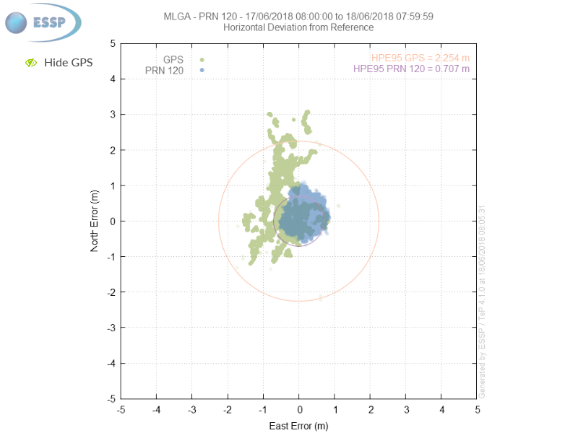
EGNOS augments GPS providing sub-metric horizontal accuracy
EGNOS and GPS (web)

Slide 10
EDAS
  Provision of EGNOS/GPS/GLONASS data through the Internet
  DGNSS and RTK corrections in the surroundings of the RIMS
  EDAS provides then four different types of data:
    GPS and GLONASS observations and navigation data collected by the entire network of EGNOS ground stations
    SBAS augmentation messages of EGNOS satellites
    RTK (Real-Time Kinematic) messages
    Differential GNSS (DGNSS) corrections

Slide 11
Table of contents
EGNOS basics: architecture and technical parameters
EGNOS benefits for mapping and GIS
EGNOS-enabled devices
EGNOS applications and success stories
EGNOS user support
Questions and answers

Slide 12
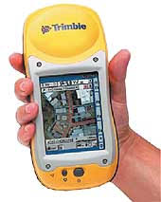


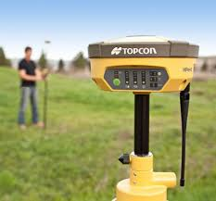


EGNOS already providing benefits for mapping and GIS professionals
EGNOS is a free-of-charge service
EGNOS signal is provided by satellite: no SIM card, no base station, no radio link, etc.
Most of the professional mapping devices are EGNOS-enabled. Users just have to activate it

Slide 13
Table of contents
EGNOS basics: architecture and technical parameters
EGNOS benefits for mapping and GIS
EGNOS-enabled devices
EGNOS applications and success stories
EGNOS user support
Questions and answers

Slide 14
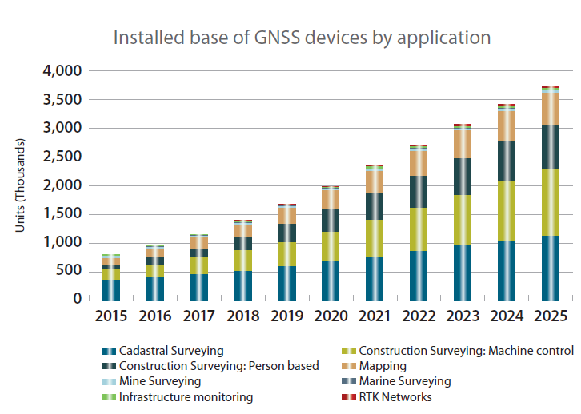


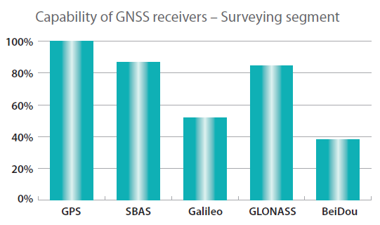

EGNOS-enabled devices for mapping
Substantial growth of the GNSS mapping and surveying market is expected
87% of GNSS receivers are EGNOS-enabled
Different types of devices:
  For pole
  Handheld
  Tablet
  Bluetooth-based (managed by a external device)
Source: GNSS Market Report - GSA

Slide 15
Configuring EGNOS in your device
1. Check that the device is EGNOS-enabled
2. Activate SBAS/EGNOS
3. Set current EGNOS satellites. E.g. PRN=120 and PRN=123. Up-to-date information in the EGNOS website
How to perform the aforementioned steps?
Product datasheet/manual
Manufacturer/dealer assistance
    EGNOS user support: egnos-helpdesk@essp-sas.eu

Slide 16
Table of contents
EGNOS basics: architecture and technical parameters
EGNOS benefits for mapping and GIS
EGNOS-enabled devices
EGNOS applications and success stories
EGNOS user support
Questions and answers

Slide 17



EGNOS applications in mapping (1/2)
Management of natural areas:
  Forests and parks
  Camping areas
  Wind farms
  etc.
Management of utility networks:
  Water
  Electricity
  Telecommunications
  etc.
Inventory and control of assets in open areas:
  Urban furniture
  Traffic signs
  etc.

Slide 18


EGNOS applications in mapping (2/2)
Taking of samples in field campaigns:
  Environmental law force agents
  Biologists
  Archeologists
  etc.
Determination of perimeters and areas:
  Municipality borders
  Urban planning
  Green cadastre
  Construction
  Dumping sites
  etc.

Slide 19
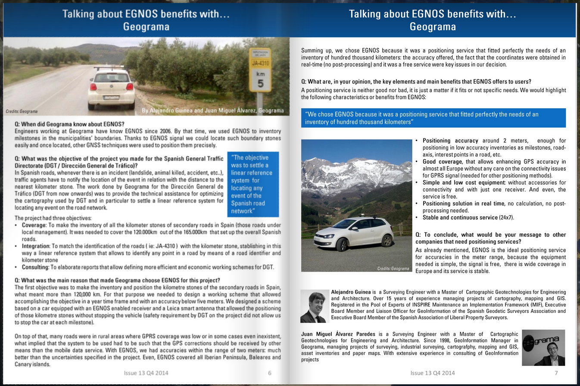
Success story 1: Inventory of road milestones
Customer: Geograma (mapping of borders and roads)
Why EGNOS?:
  Improvement of GPS positioning accuracy
  Good wide coverage
  Simple and low cost equipment
  Real-time solution
  Stable and continuous service
All the information is here

Slide 20

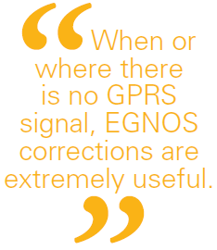
Success Story 2: Management of natural areas
Customer: ORTIZ-EULEN (maintenance of forestry parks)
Why EGNOS?:
  Improvement of GPS positioning accuracy
  Less time needed for taking great number of measurements
  Wide coverage
  Light (handheld) equipment
All the information is here

Slide 21
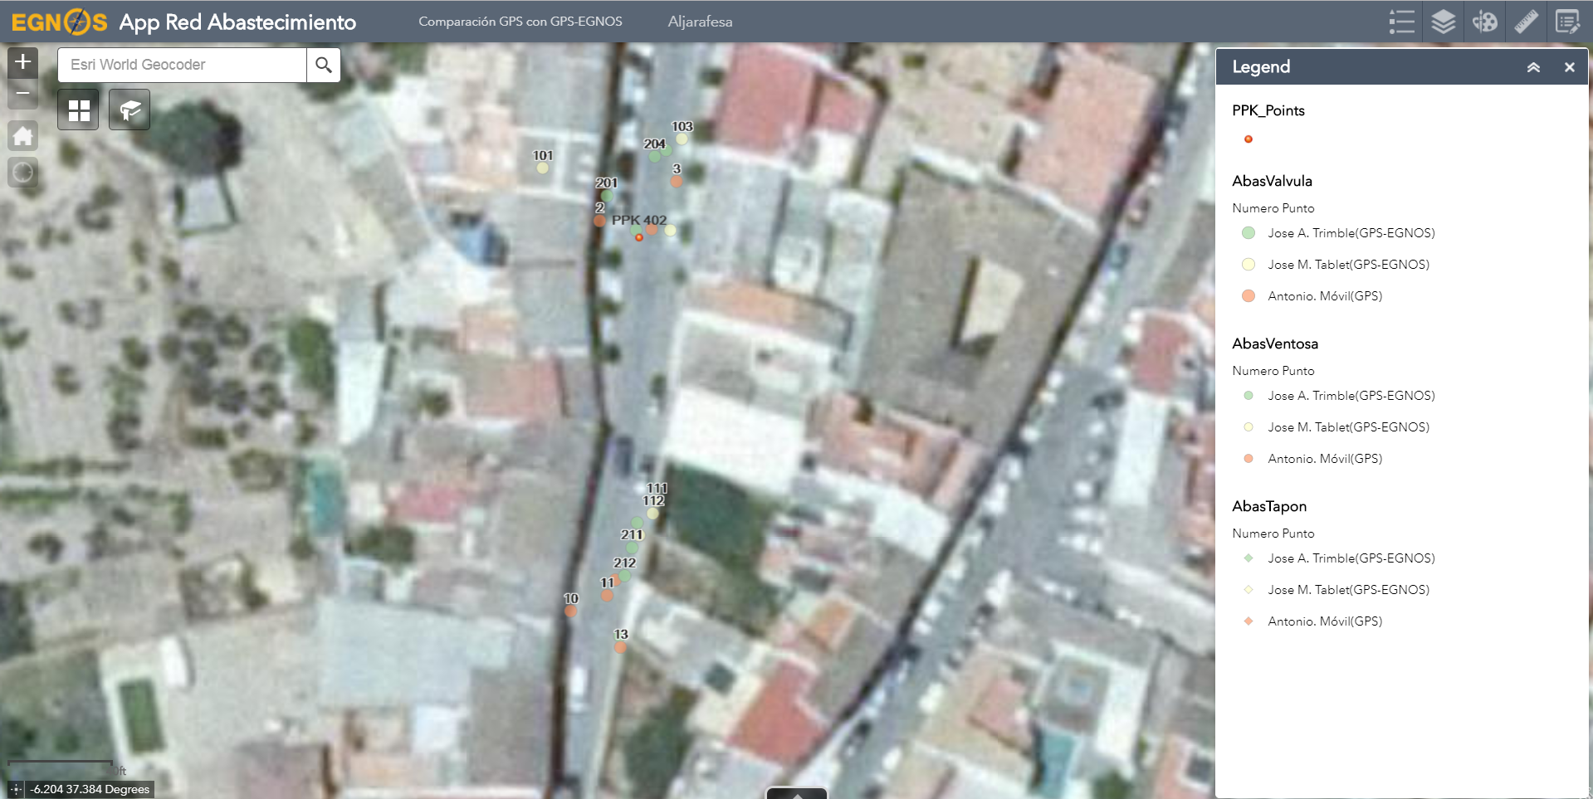
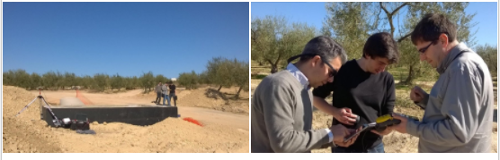
Success story 3: Management of water supply networks maintenance
Customer: Aljarafesa (maintenance of utility networks)
Why EGNOS?:
  Improvement of GPS positioning accuracy
  No cost
  Less time needed for taking great number of measurements
  Good wide coverage
  Light (handheld) equipment

Slide 22
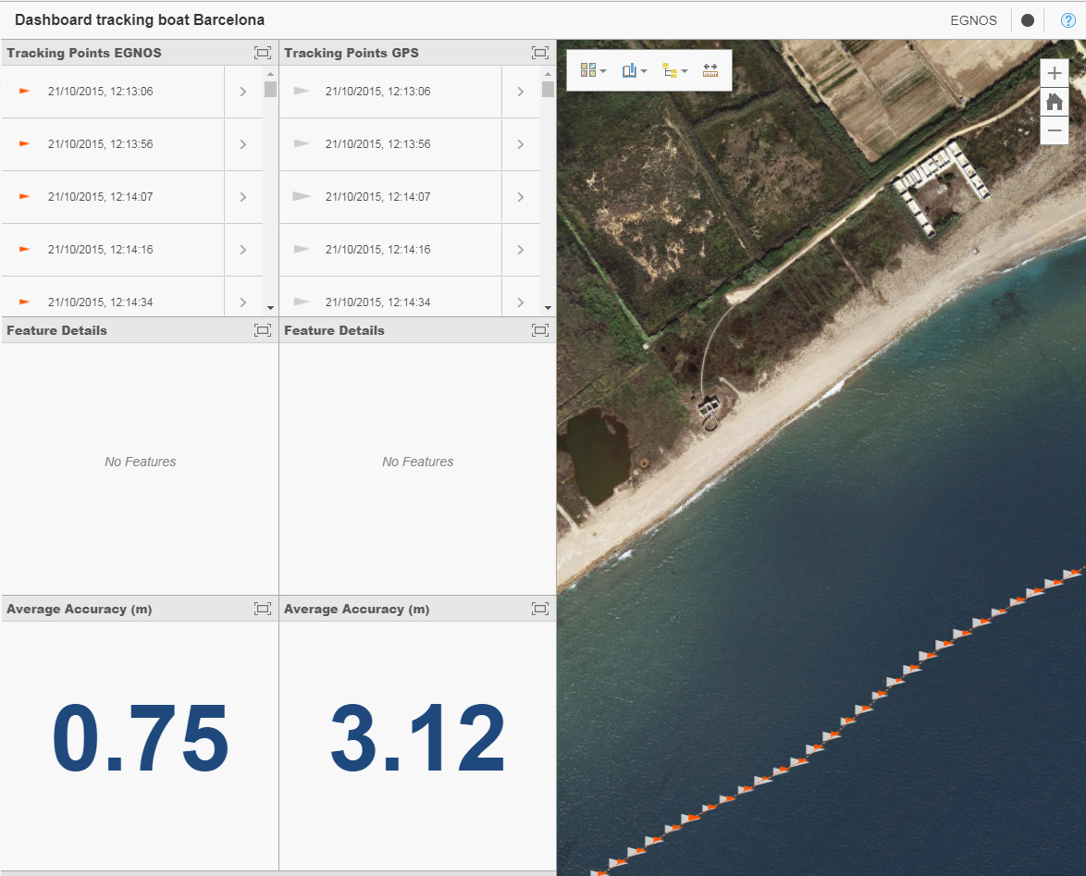
Success story 4: Harbour mapping (bathymetry and coastline monitoring)
Customer: Port of Barcelona (harbour’s authority)
Why EGNOS?:
  Improvement of GPS positioning accuracy
  No cost
  Good wide coverage
  Simple and low cost equipment
All information is here and here

Slide 23
Table of contents
EGNOS basics: architecture and technical parameters
EGNOS benefits for mapping and GIS
EGNOS-enabled devices
EGNOS applications and success stories
EGNOS user support
Questions and answers

Slide 24
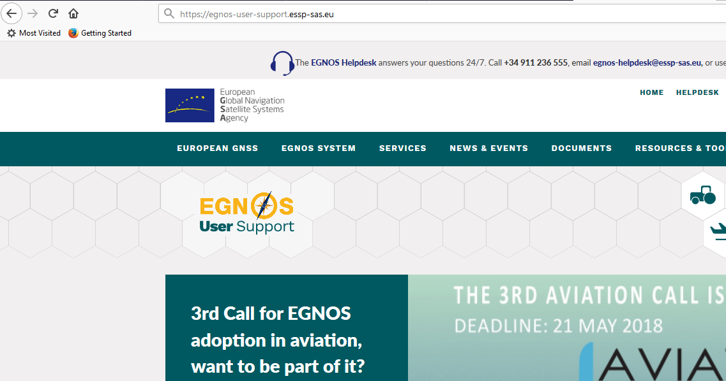
EGNOS user support website

Slide 25

EGNOS app
Android: https://play.google.com/store/apps/details?id=com.essp.egnosapp
iOS: https://itunes.apple.com/us/app/egnos/id1346540596?l=es&ls=1&mt=8

Slide 26
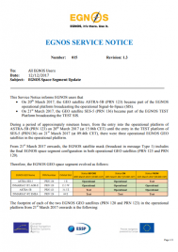
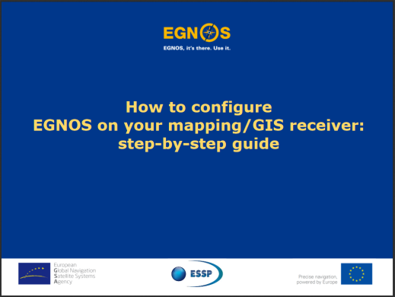

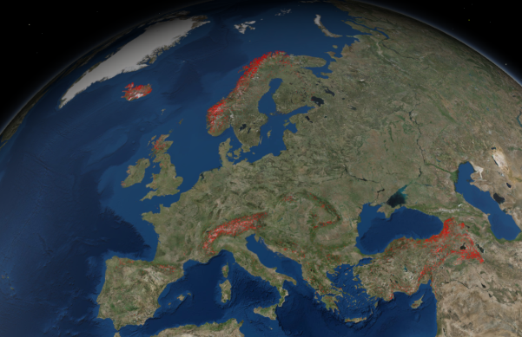
Summary of useful links
EGNOS User Support Website: http://egnos-user-support.essp-sas.eu
Service Notices (e.g. PRN modifications)
Real-time performance:
  EGNOS vs GPS
  EDAS
Historical performance
Guidance material
Visibility maps
EGNOS bulletin
EGNOS helpdesk

Slide 27
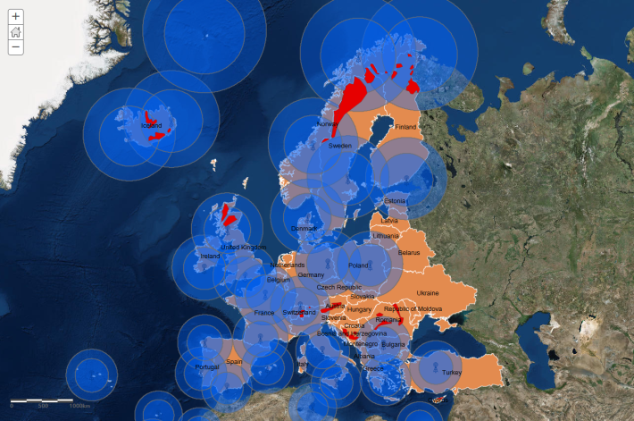
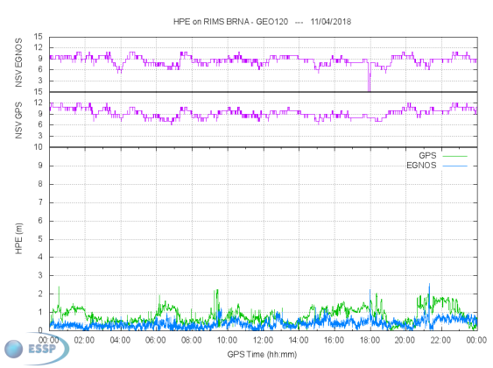
Coming soon in the EGNOS user support website
EDAS coverage maps
EGNOS verification guidelines
  If EGNOS is being applied for PVT computation
  Using the information logged by the equipment
  Other means in case no log data is available

Slide 28
Table of contents
EGNOS basics: architecture and technical parameters
EGNOS benefits for mapping and GIS
EGNOS-enabled devices
EGNOS applications and success stories
EGNOS user support
Questions and answers

Slide 29
QUeSTIONS and answers
http://egnos-user-support.essp-sas.eu
egnos-helpdesk@essp-sas.eu
+34 911 236 555 (H24/7)
www.essp-sas.eu
Corporate Video

Slide 30
QUeSTIONS and answers
http://egnos-user-support.essp-sas.eu
egnos-helpdesk@essp-sas.eu
+34 911 236 555 (H24/7)
www.essp-sas.eu
Corporate Video

Slide 31
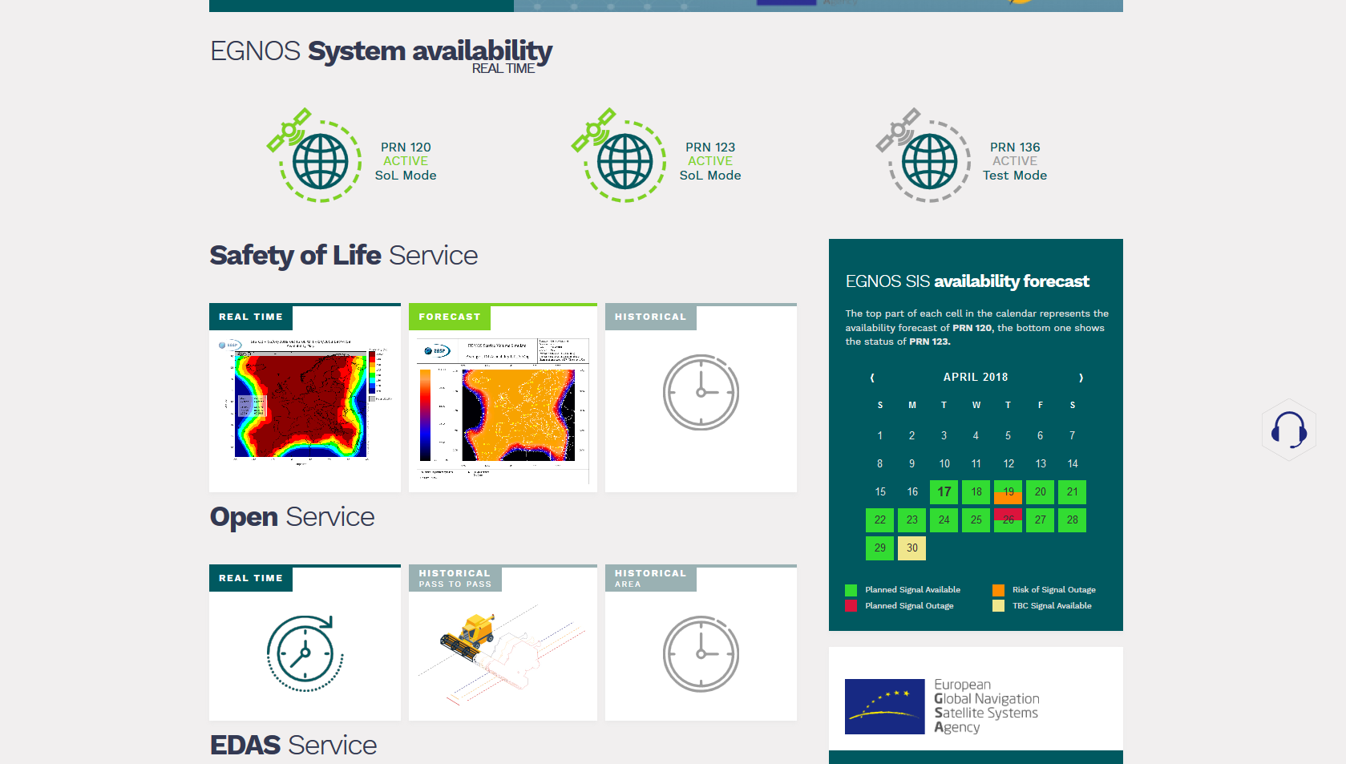
EGNOS satellites availability

Slide 32
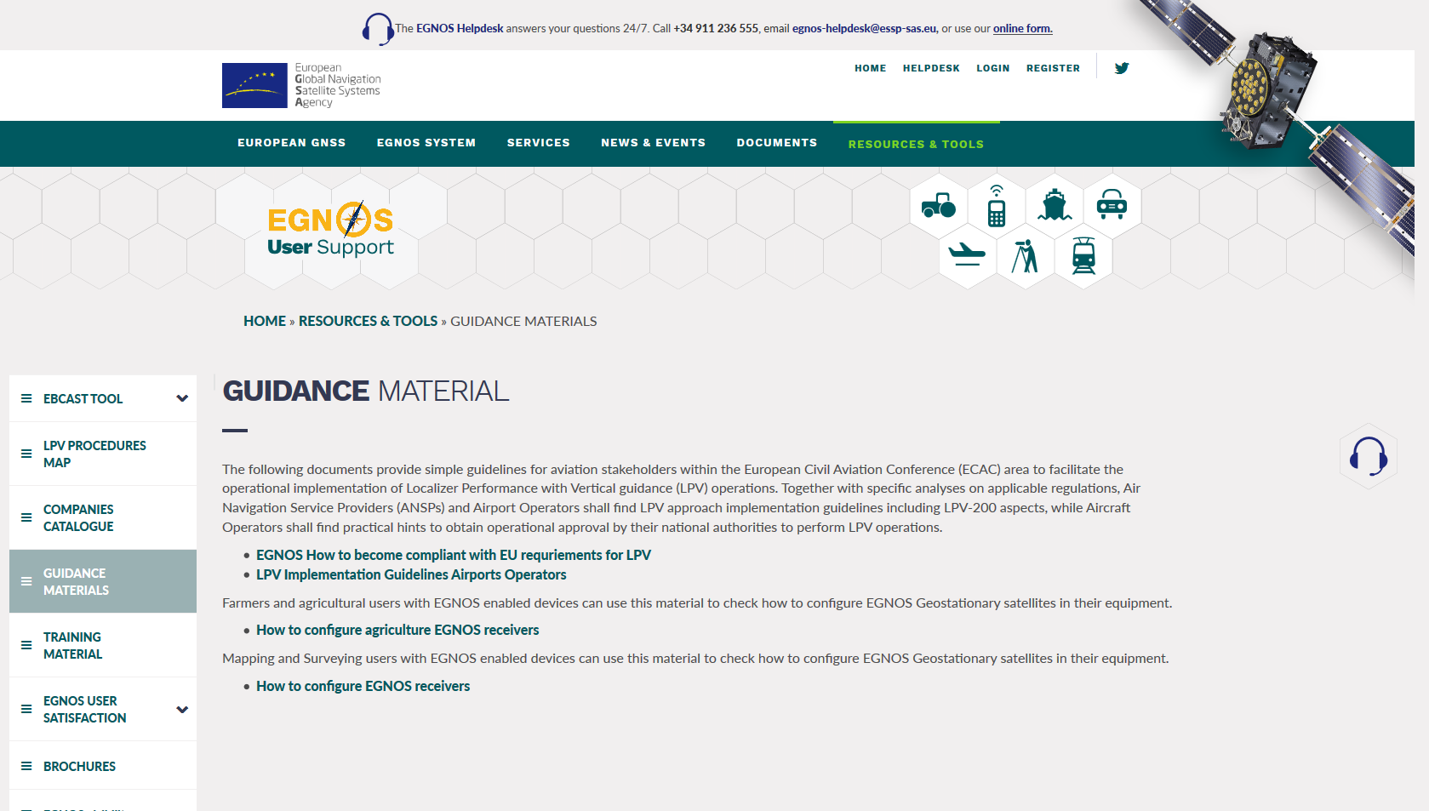
EGNOS adoption material

Slide 33
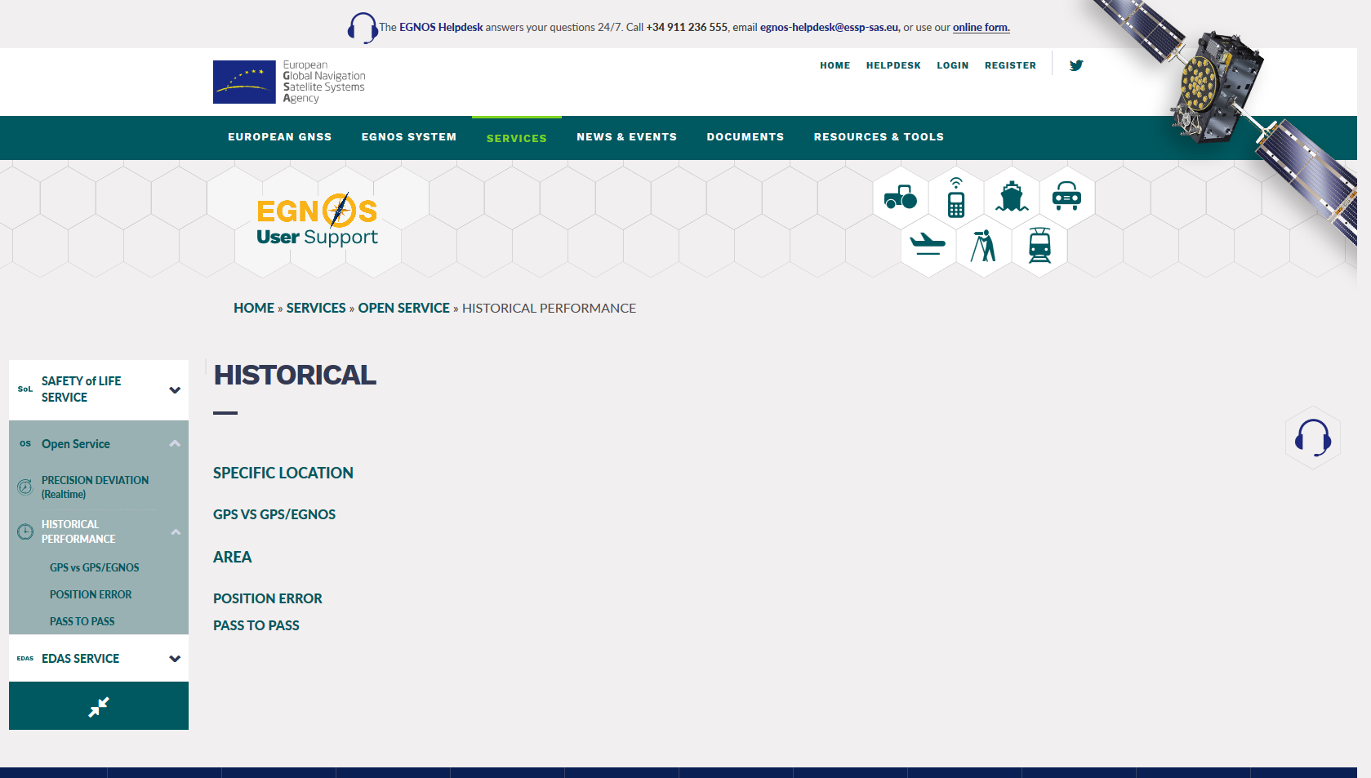
EGNOS historical performance

Slide 34
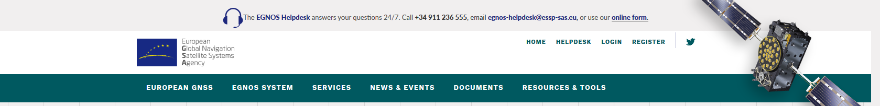
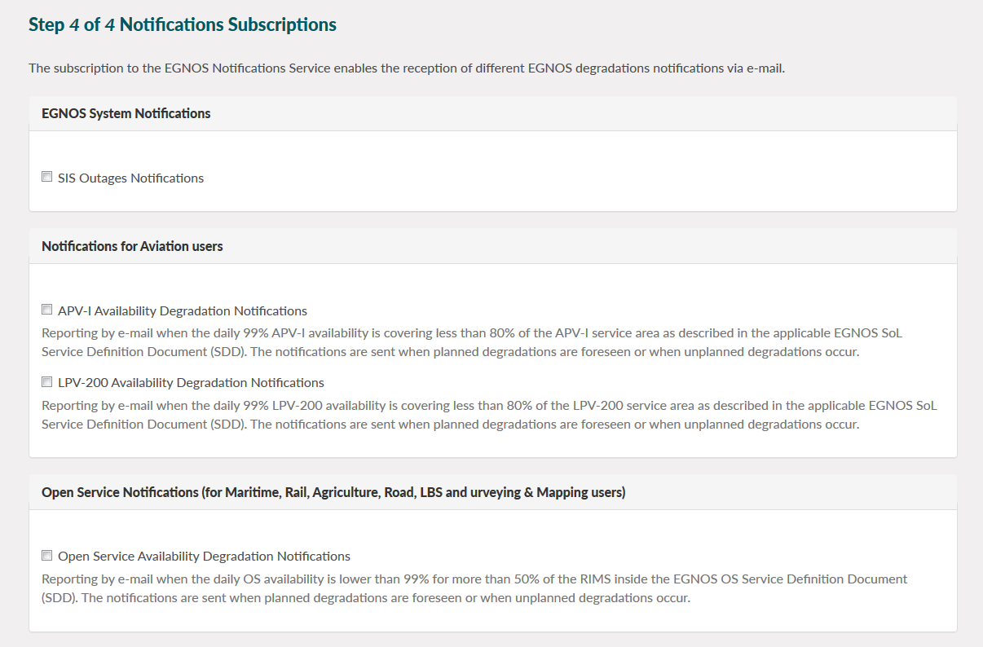
Registration and notification subscription
1. Registration in the EGNOS user support website (top right)
2. Interesting subscriptions to be selected during registration
Aviation-related (of no interest for mapping)

Slide 35

EGNOS visibility maps
EGNOS is available over all Europe, but the terrain orography could affect the visibility of EGNOS satellites. Visibility maps provided in the EGNOS User Support Website.

Slide 36
EDAS
 | EDAS Service | Type of Data |  |  |  | Service Description
 |  | OBS & NAV | EGNOS MSG | RTK MSG | DGNSS COR | FORMAT | PROTOCOL
  GPS and GLONASS observations and navigation data collected by the entire network of EGNOS ground stations.
  SBAS augmentation messages of EGNOS satellites.
  RTK (Real-Time Kinematic) messages.
  Differential GNSS (DGNSS) corrections.

Slide 37
EDAS
 | EDAS Service | Type of Data |  |  |  | Service Description
 |  | OBS & NAV | EGNOS MSG | RTK MSG | DGNSS COR | FORMAT | PROTOCOL
Real Time | Service Level 0 Data Filtering SL0 |  |  |  |  | ASN.1 | EDAS
 | Service Level 2 Data Filtering SL2 |  |  |  |  | RTCM3.1 | EDAS
 | SISNeT |  |  |  |  | RTCA | SISNeT
 | NTRIP |  |  |  |  | RTCM 2.x, RTCM 3.1 | NTRIP
Archive | FTP |  |  |  |  | RINEX, EMS, IONEX… | FTP

